Slide 1
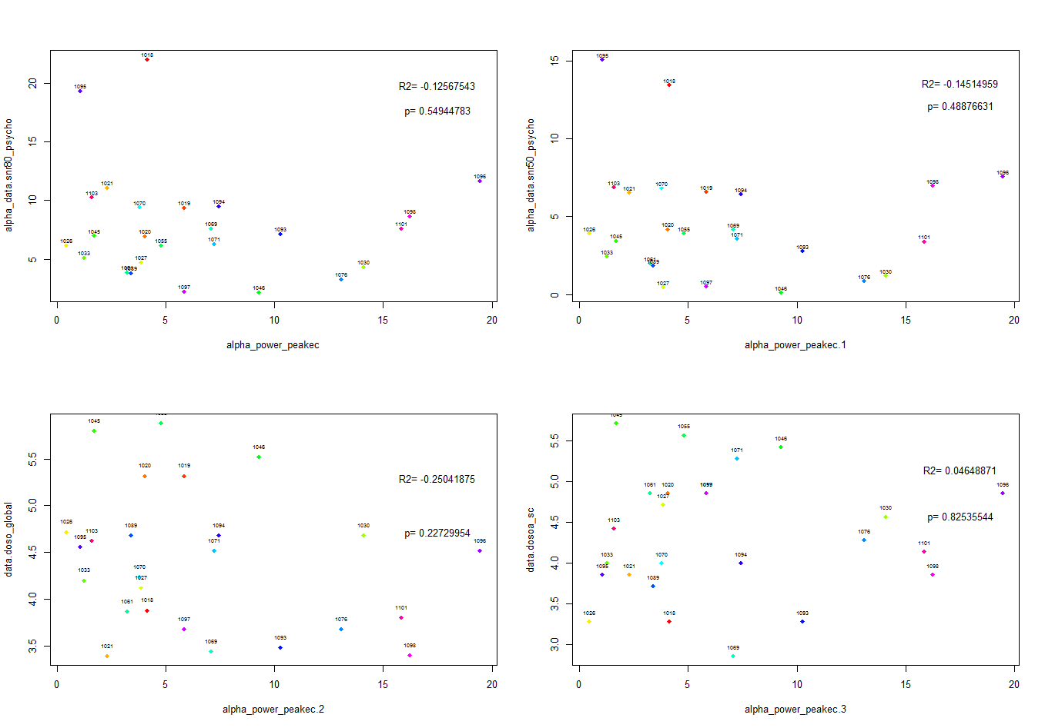
Alpha power peak (eyes closed)-SNR80
Alpha power peak (eyes closed)-SNR50
Alpha power peak (eyes closed)-doso_global
Alpha power peak (eyes closed)-dosoa_sc (speech cues)

Slide 2
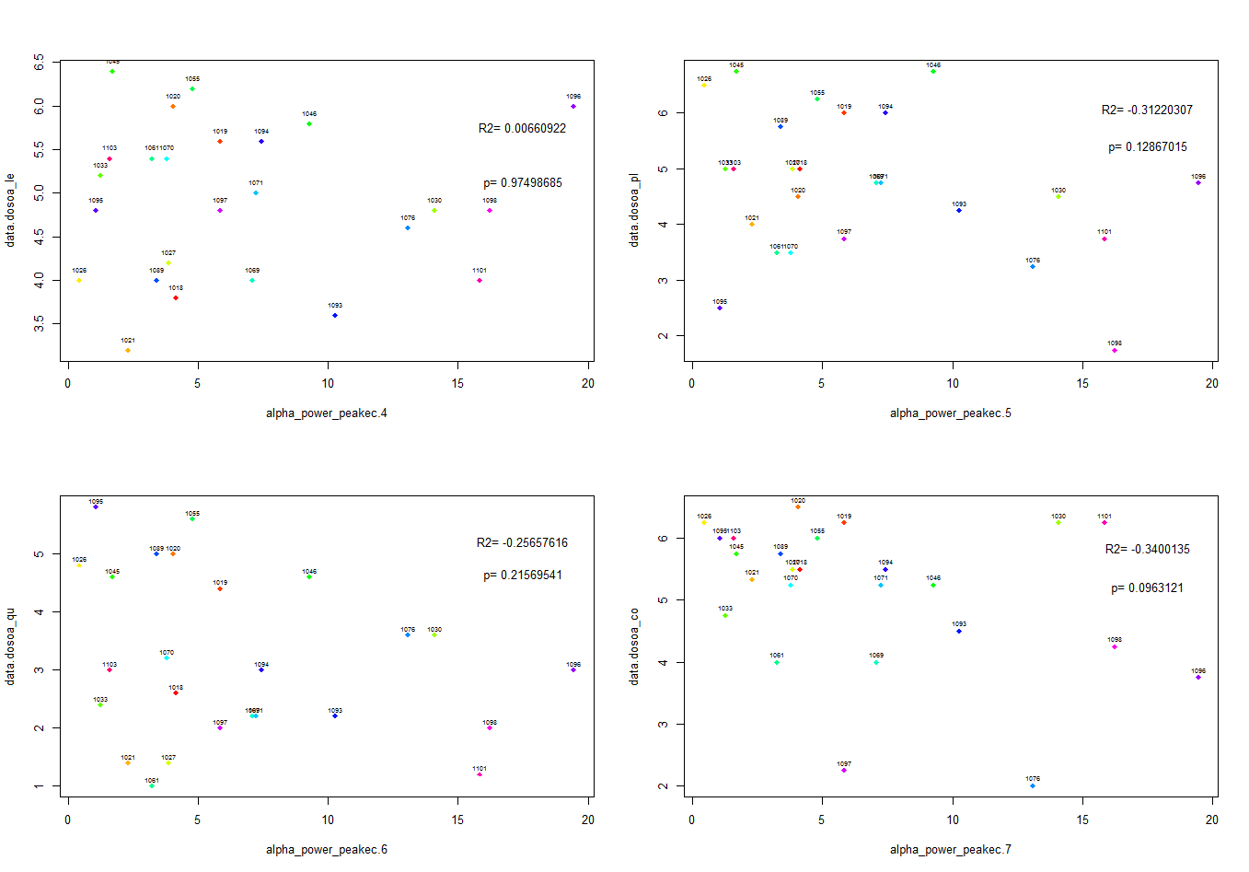
Alpha power peak (EC)-DOSOA (listening effort)
Alpha power peak (EC)-DOSOA_pleasantness
Alpha power peak (EC)-DOSOA_quietness
Alpha power peak (EC)-dosoa_co (convenience)

Slide 3
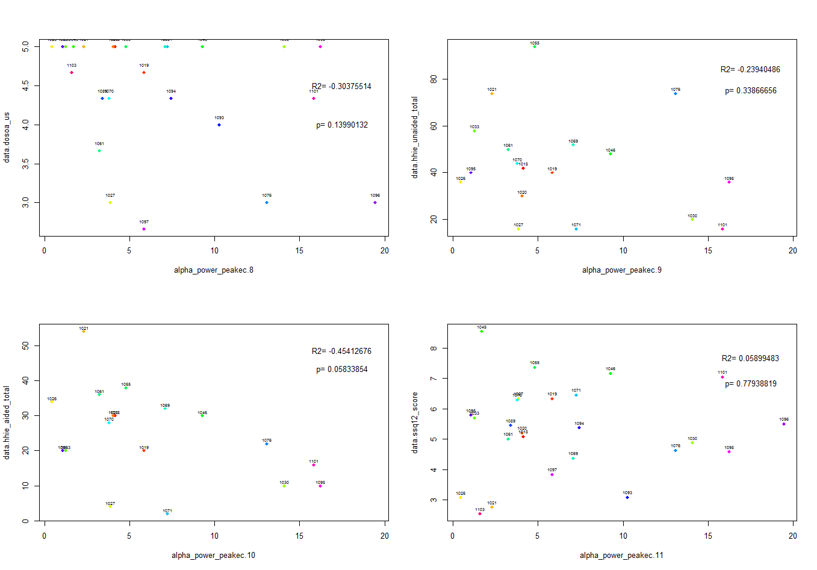
Alpha power peak (EC)-DOSOA (use)
Alpha power peak (EC)-HHIE unaided total
Alpha power peak (EC)-HHIE aided total
Alpha power peak (EC)-SSQ 12

Slide 4
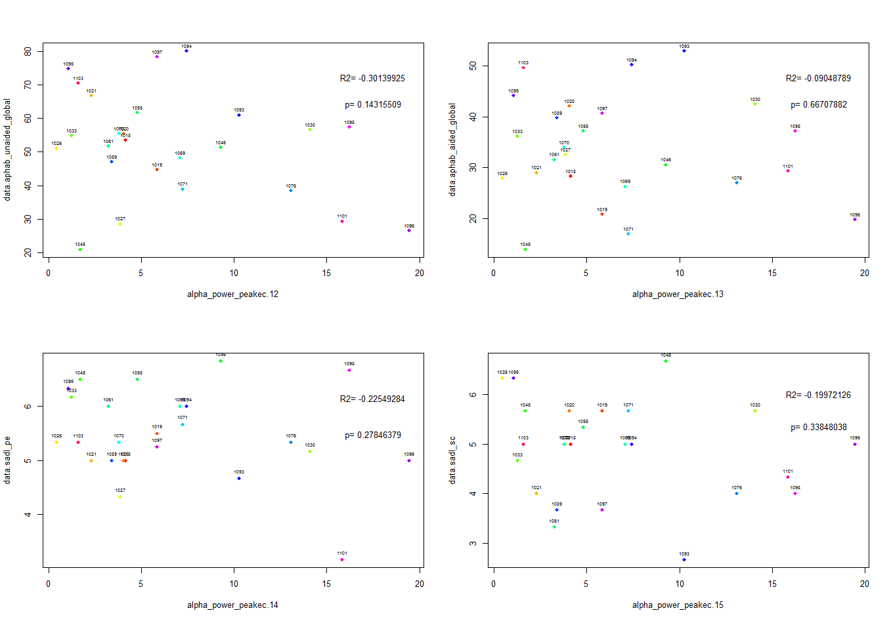
Alpha power peak (EC)-aphab unaided global
Alpha power peak (EC)-aphab aided global
Alpha power peak (EC)-sadl positive effect scale
Alpha power peak (EC)-service and cost

Slide 5
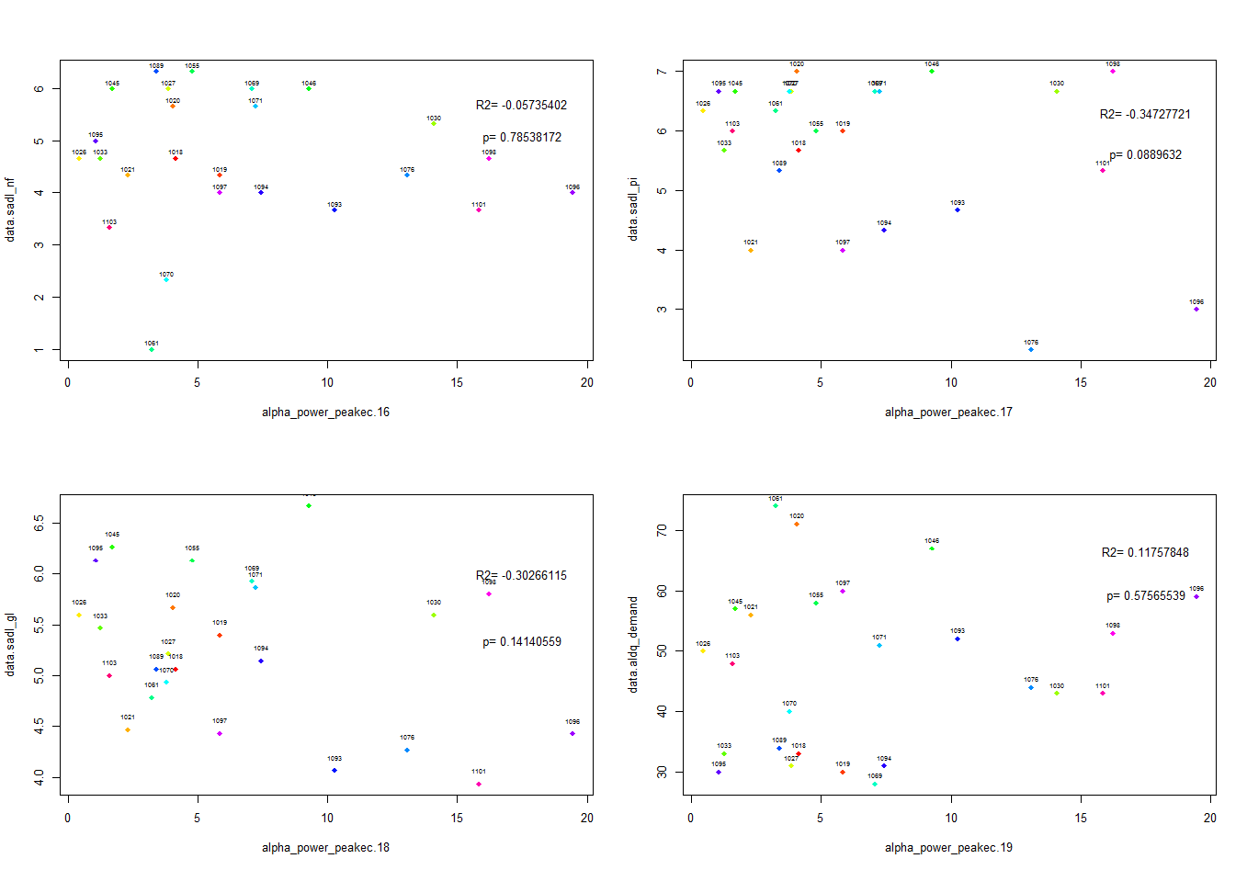
Alpha power peak (EC)-sadl negative features
Alpha power peak (EC)-sadl personal image
Alpha power peak (EC)-sadl global
Alpha power peak (EC)-aldq demand

Slide 6
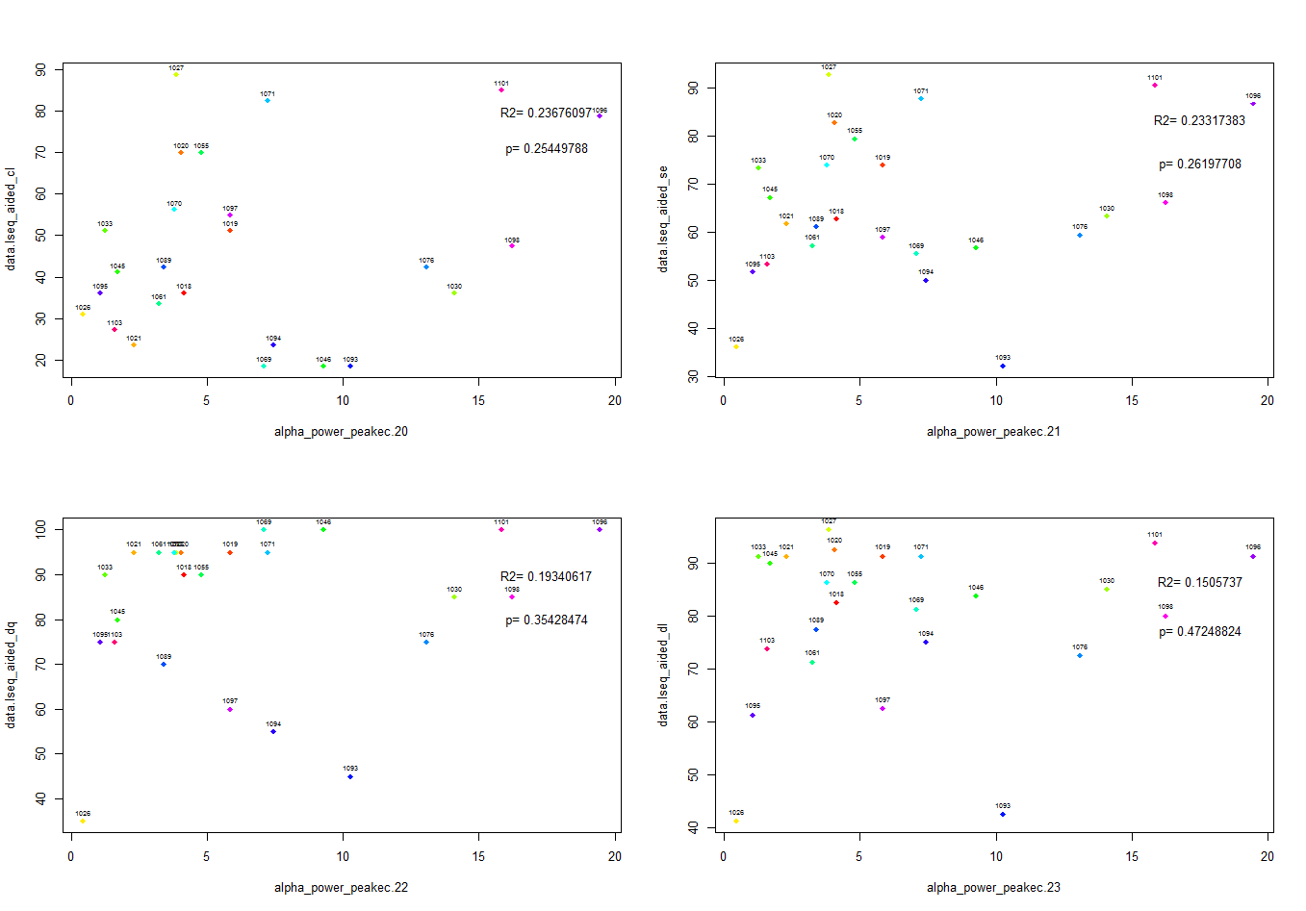
Alpha power peak (EC)-lseq aided complex listening
Alpha power peak (EC)-lseq aided self-efficacy
Alpha power peak (EC)-lseq aided one on one
dialogue in quiet settings
Alpha power peak (EC)-lseq aided directed listening

Slide 7
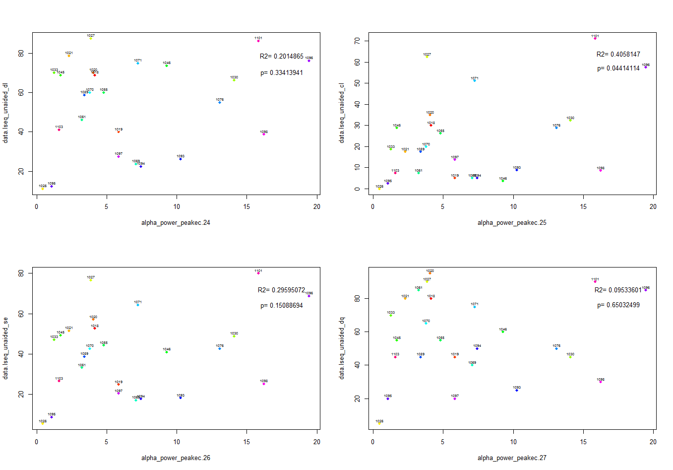
Alpha power peak (EC)-lseq unaided directed listening
Alpha power peak (EC)-lseq unaided complex listening
Alpha power peak (EC)-lseq unaided self efficacy
Alpha power peak (EC)-lseq unaided one-on-one
dialogue in quiet settings

Slide 8
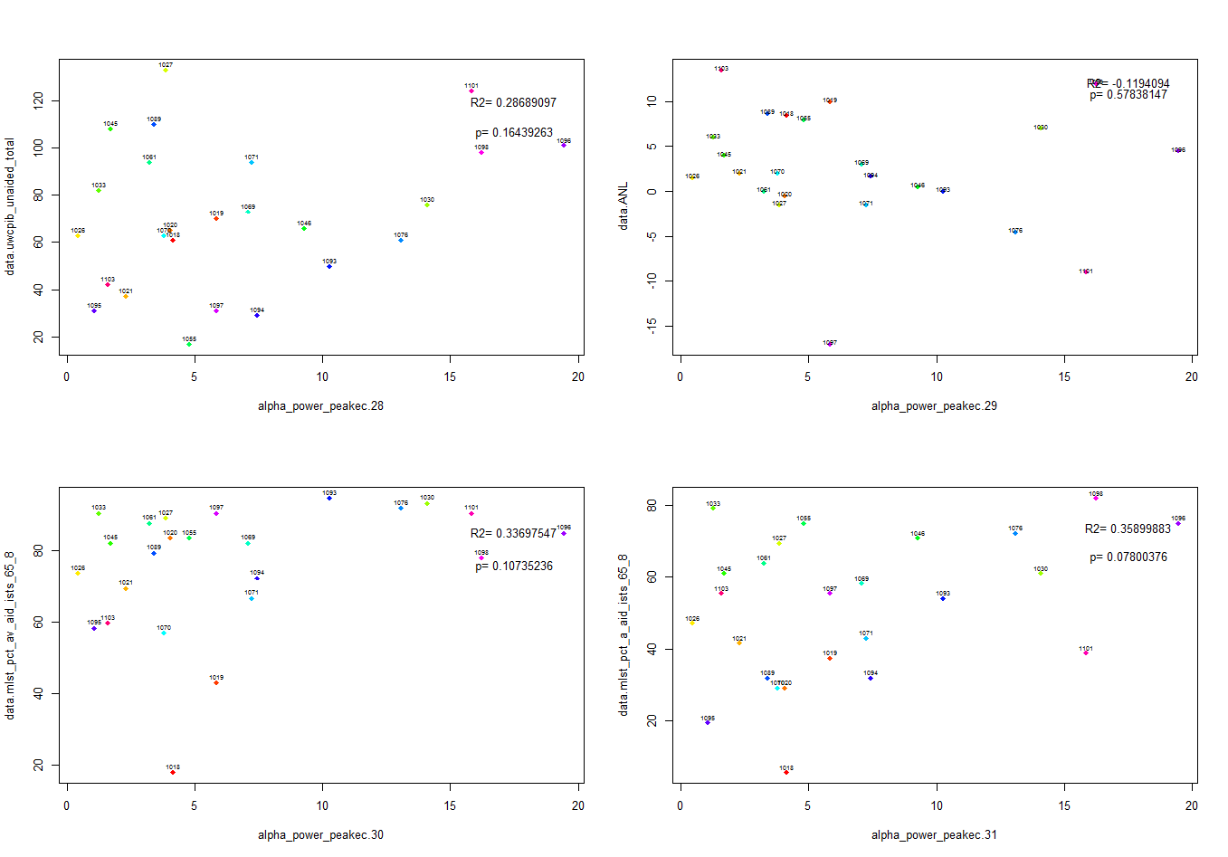
Alpha power peak (EC)-
Alpha power peak (EC)-ANL
Alpha power peak (EC)-MLST pct_av_aid_ists_65-8
Alpha power peak (EC)-MLST pct_a_aid_ists_65-8

Slide 9
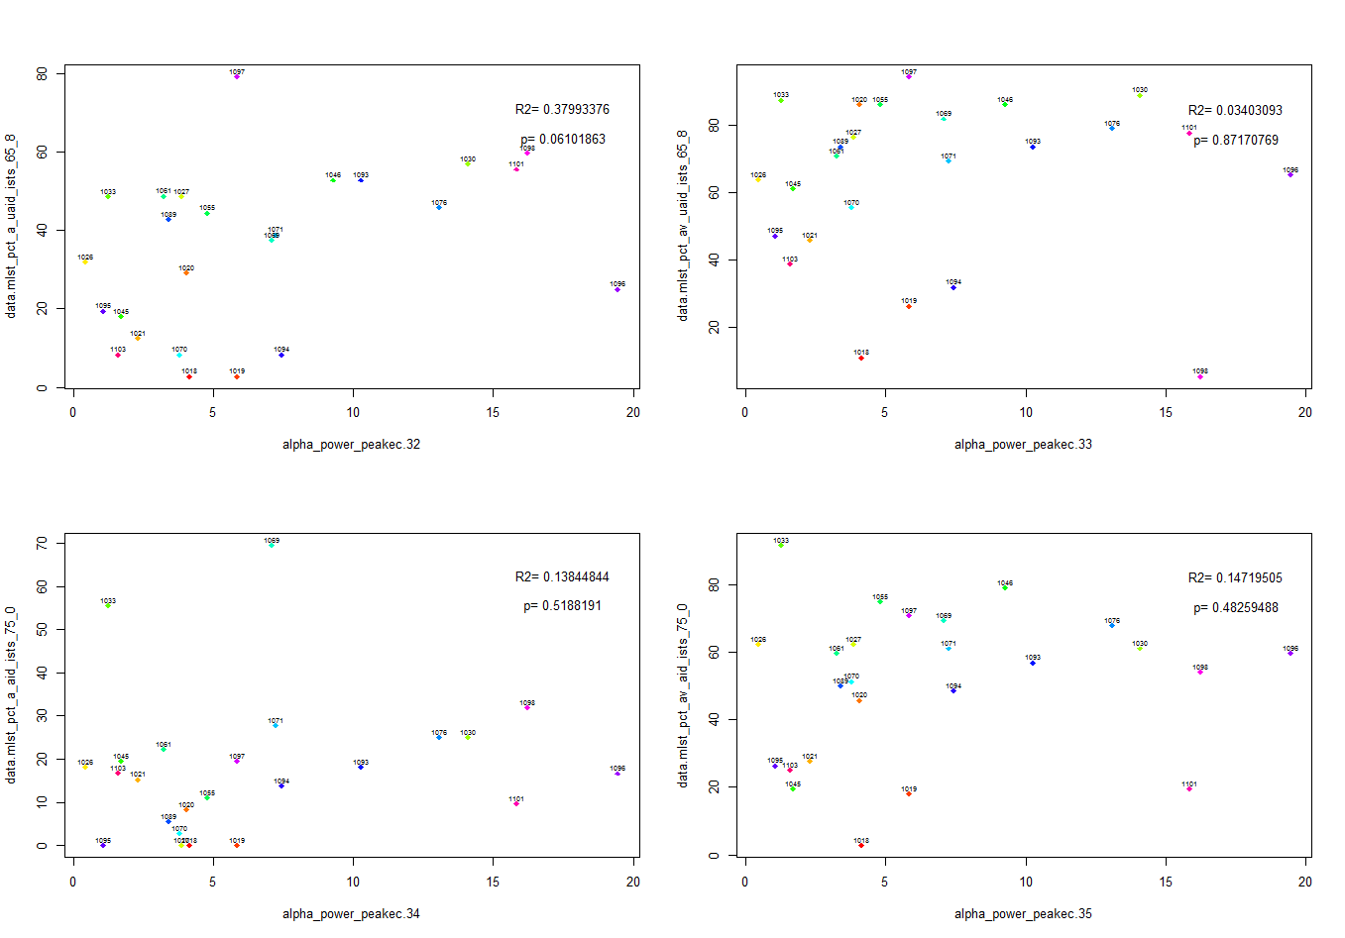
Alpha power peak (EC)-MLST pct a unaided ISTS 65 8
Alpha power peak (EC)-MLST pct av unaided ISTS 65 8
Alpha power peak (EC)-MLST pct a aid ISTS 75 0
Alpha power peak (EC)-MLST pct av aid ISTS 75 0

Slide 10
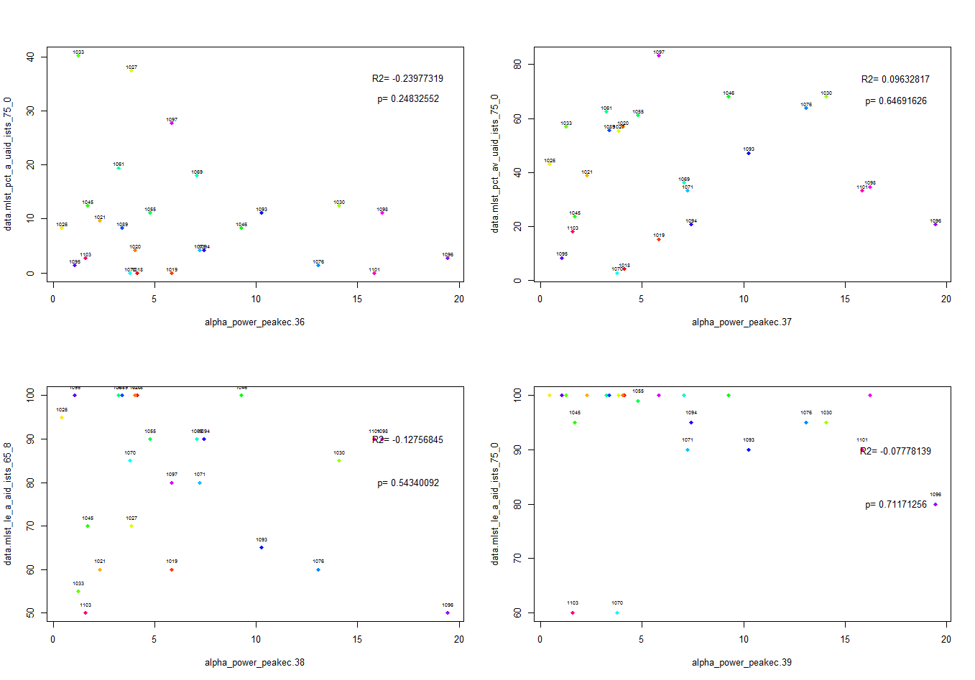
Alpha power peak (EC)-MLST pct a unaided ISTS 75 0
Alpha power peak (EC)-MLST pct av unaided ISTS 75 0
Alpha power peak (EC)-MLST LE a aid ISTS 65 8
Alpha power peak (EC)-MLST Lea aid ISTS 75 0

Slide 11
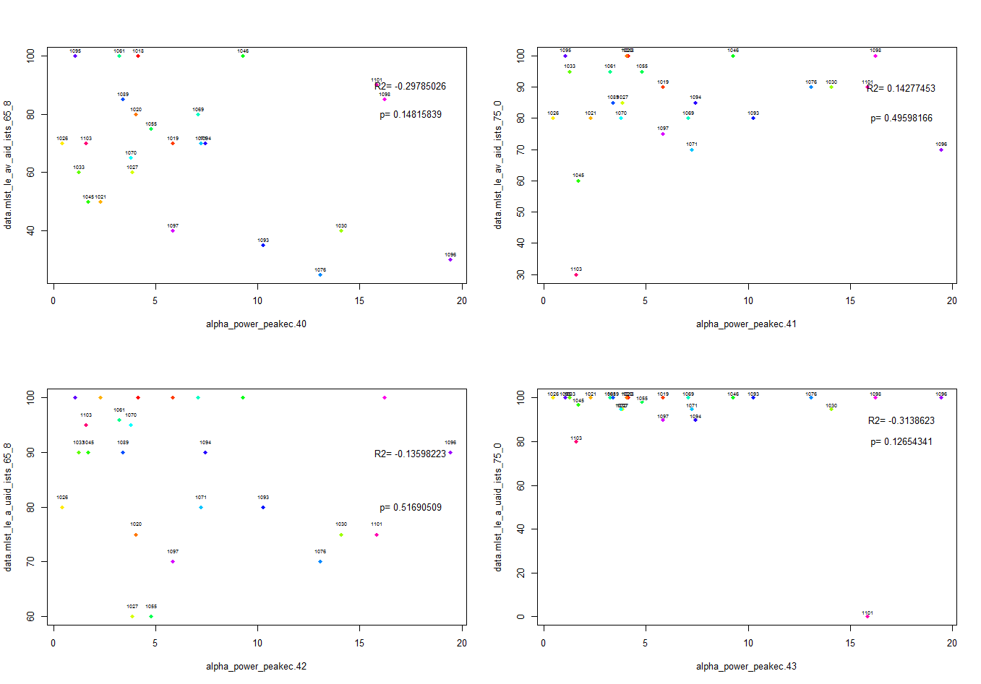
Alpha power peak (EC)-MLST LE av aid ISTS 65 8
Alpha power peak (EC)-MLST le av aid ISTS 75 0
Alpha power peak (EC)-MLST LE A unaided ISTS 75 0
Alpha power peak (EC)-MLST LE a unaided ISTS 65 8

Slide 12
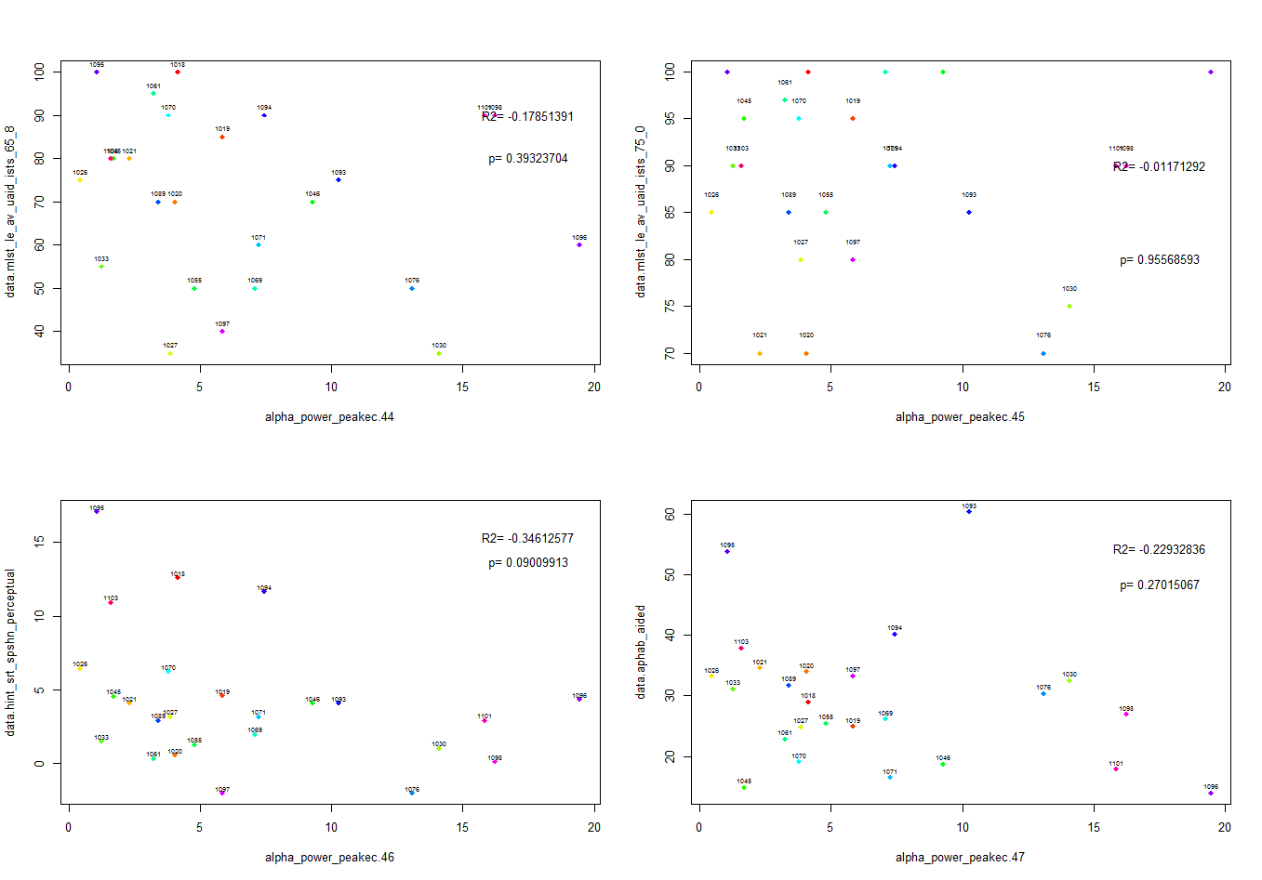
Alpha power peak (EC)-MLST LE av unaided ISTS 65 8
Alpha power peak (EC)-MLST LE av unaided ISTS 75 0
Alpha power peak (EC)-HINT SRT SPSHN perceptual
Alpha power peak (EC)-aphab aided

Slide 13
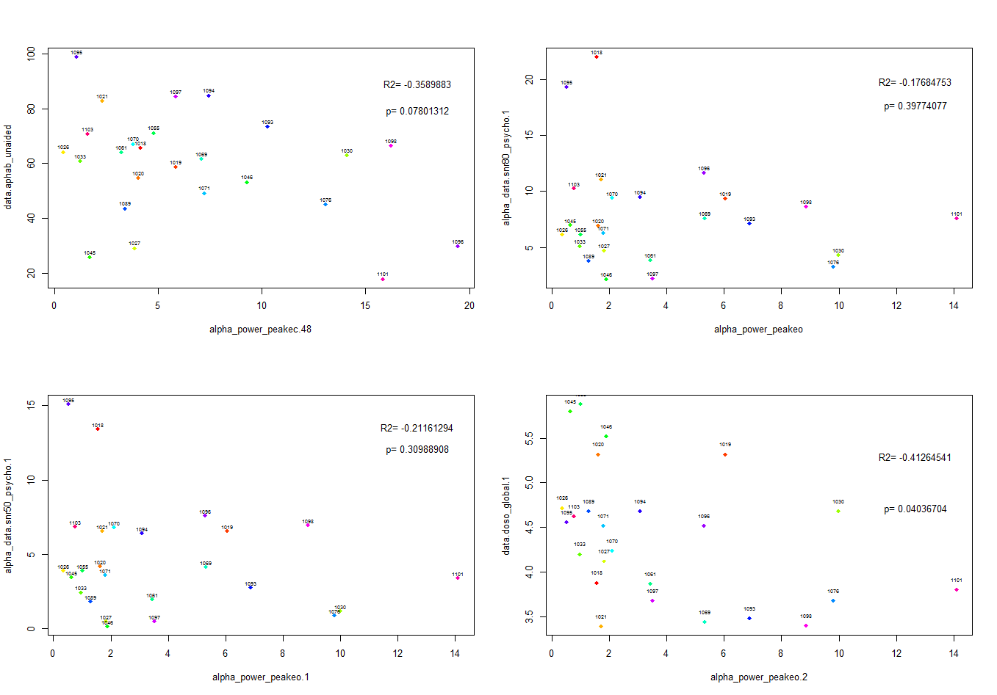
Alpha power peak (EC)-aphab unaided
Alpha power peak (EC)-SNR80
Alpha power peak (EC)-SNR 50
Alpha power peak (EC)-DOSO global

Slide 14
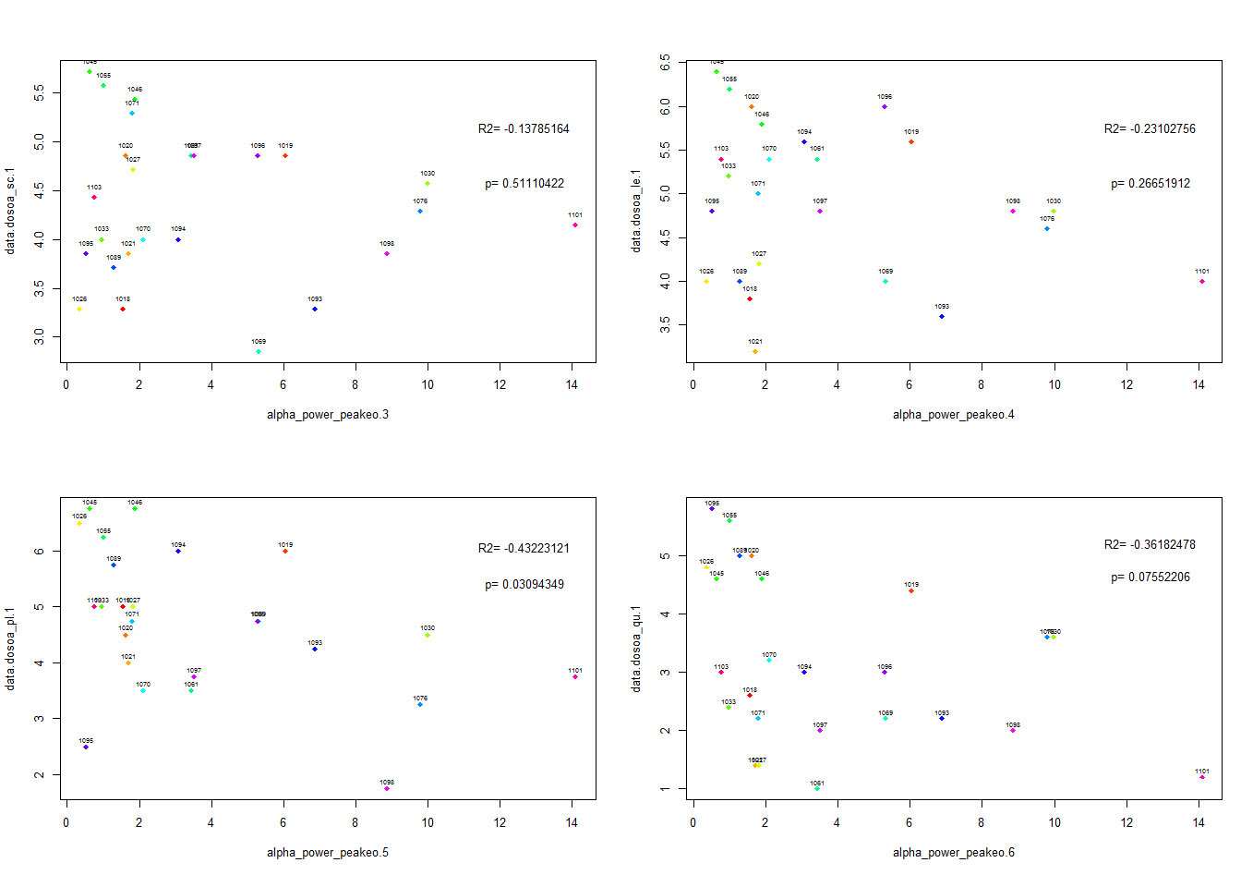
Alpha power peak (eyes closed)-dosoa_sc (speech cues)
Alpha power peak (EC)-DOSOA (listening effort)
Alpha power peak (EC)-DOSOA_pleasantness
Alpha power peak (EC)-DOSOA_quietness

Slide 15
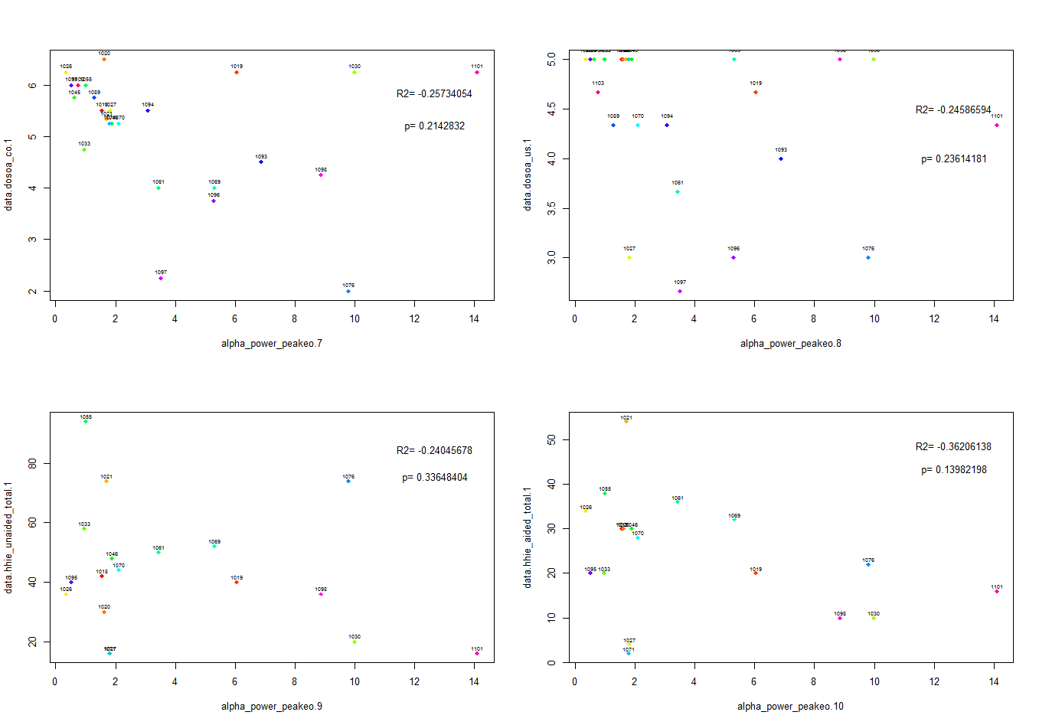
Alpha power peak (EC)-dosoa_co (convenience)
Alpha power peak (EC)-DOSOA (use)
Alpha power peak (EC)-HHIE unaided total
Alpha power peak (EC)-HHIE aided total

Slide 16
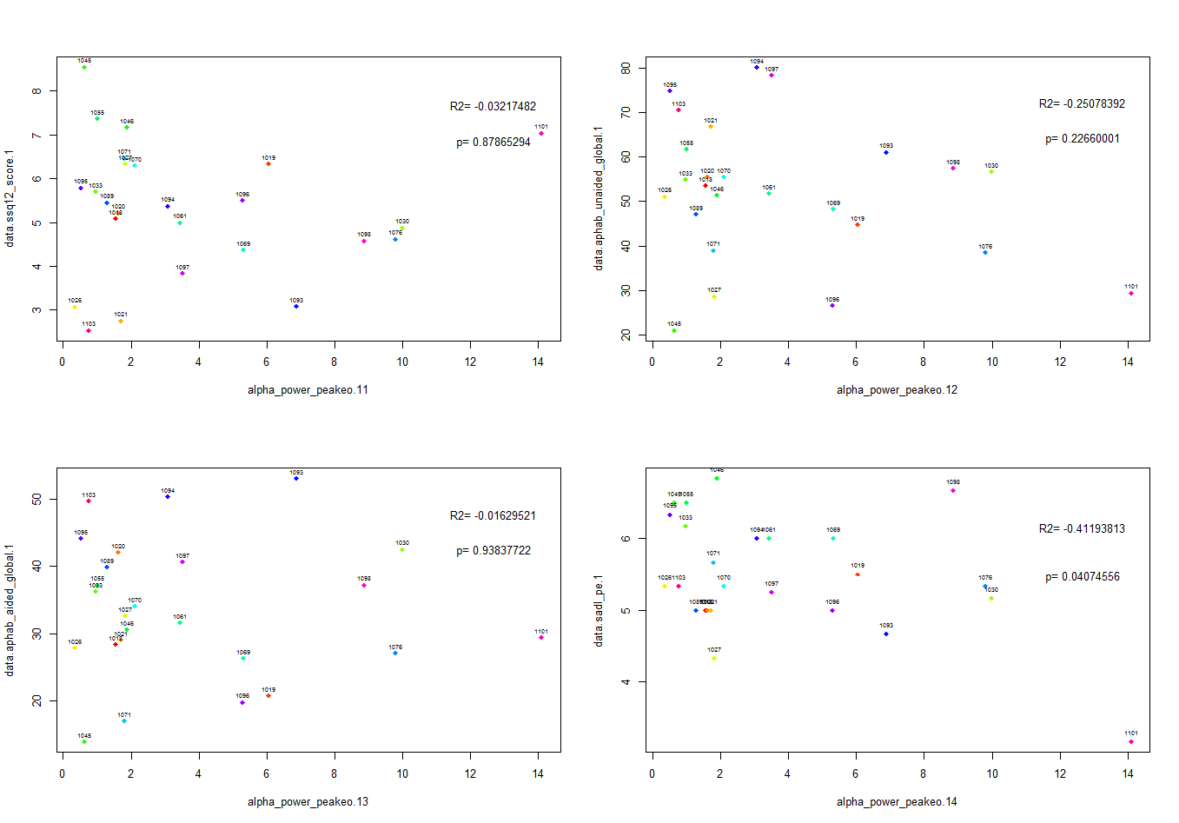
Alpha power peak (EC)-SSQ 12
Alpha power peak (EC)-aphab unaided global
Alpha power peak (EC)-sadl positive effect scale
Alpha power peak (EC)-aphab aided global

Slide 17
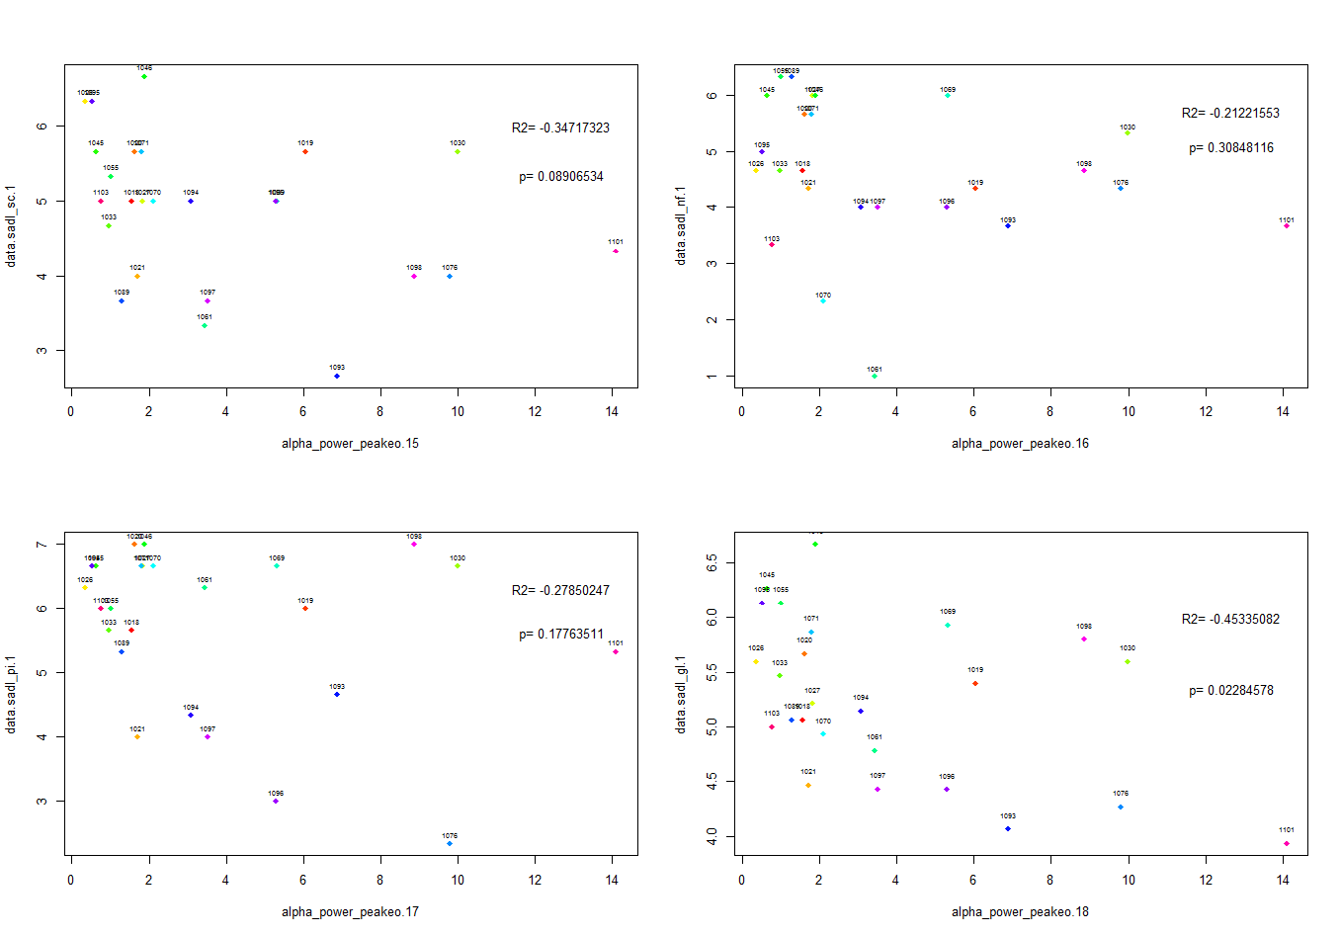
Alpha power peak (EC)-service and cost
Alpha power peak (EC)-sadl negative features
Alpha power peak (EC)-sadl personal image
Alpha power peak (EC)-sadl global

Slide 18
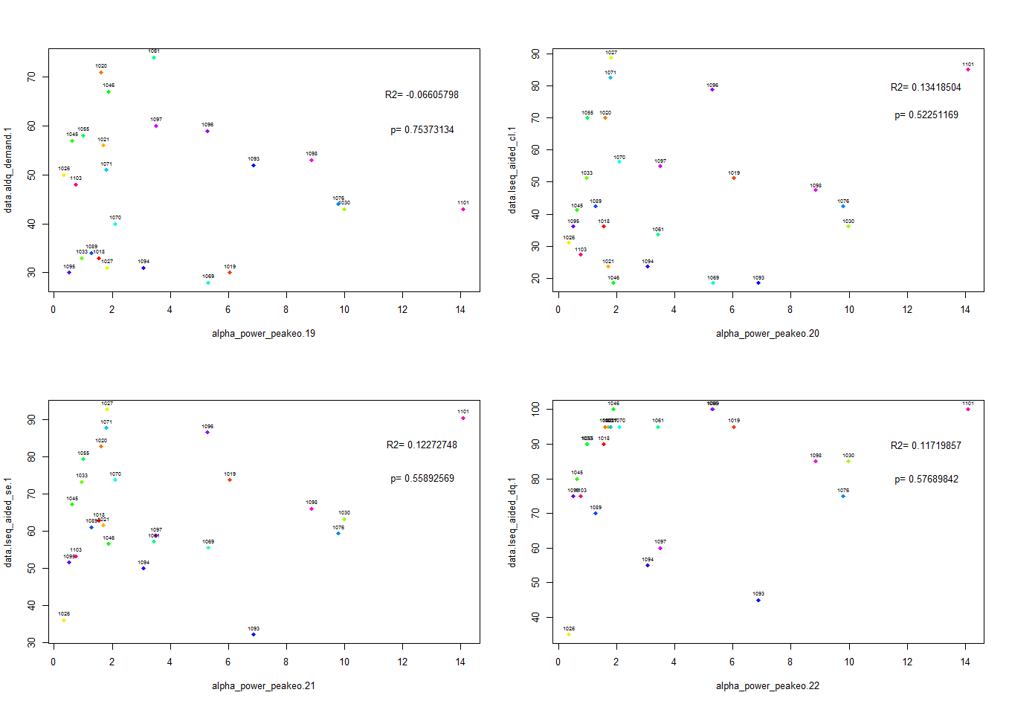
Alpha power peak (EC)-aldq demand
Alpha power peak (EC)-lseq aided complex listening
Alpha power peak (EC)-lseq aided self efficacy
Alpha power peak (EC)-lseq aided one-on-one
dialogue in quiet settings

Slide 19
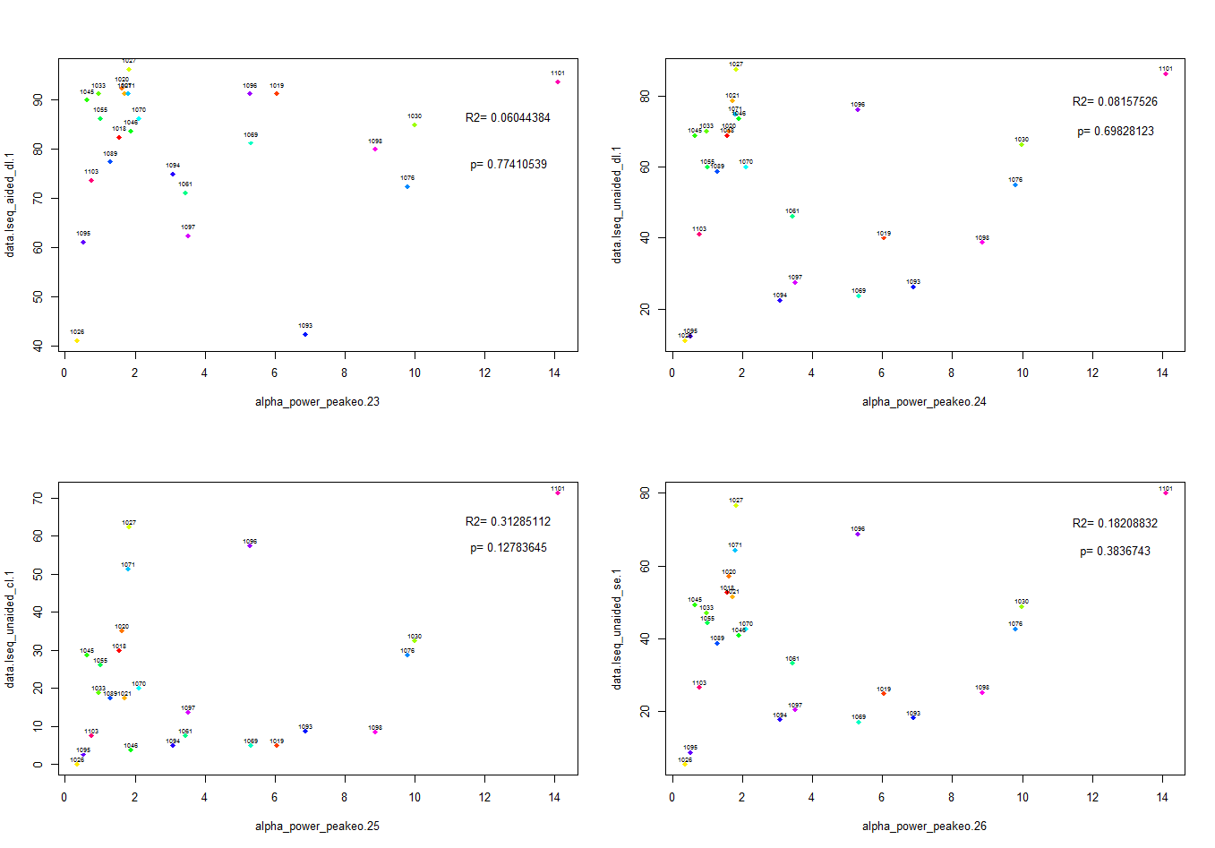
Alpha power peak (EC)-lseq aided directed listening
Alpha power peak (EC)-lseq unaided directed listening
Alpha power peak (EC)-lseq unaided complex listening
Alpha power peak (EC)-lseq unaided self efficacy

Slide 20
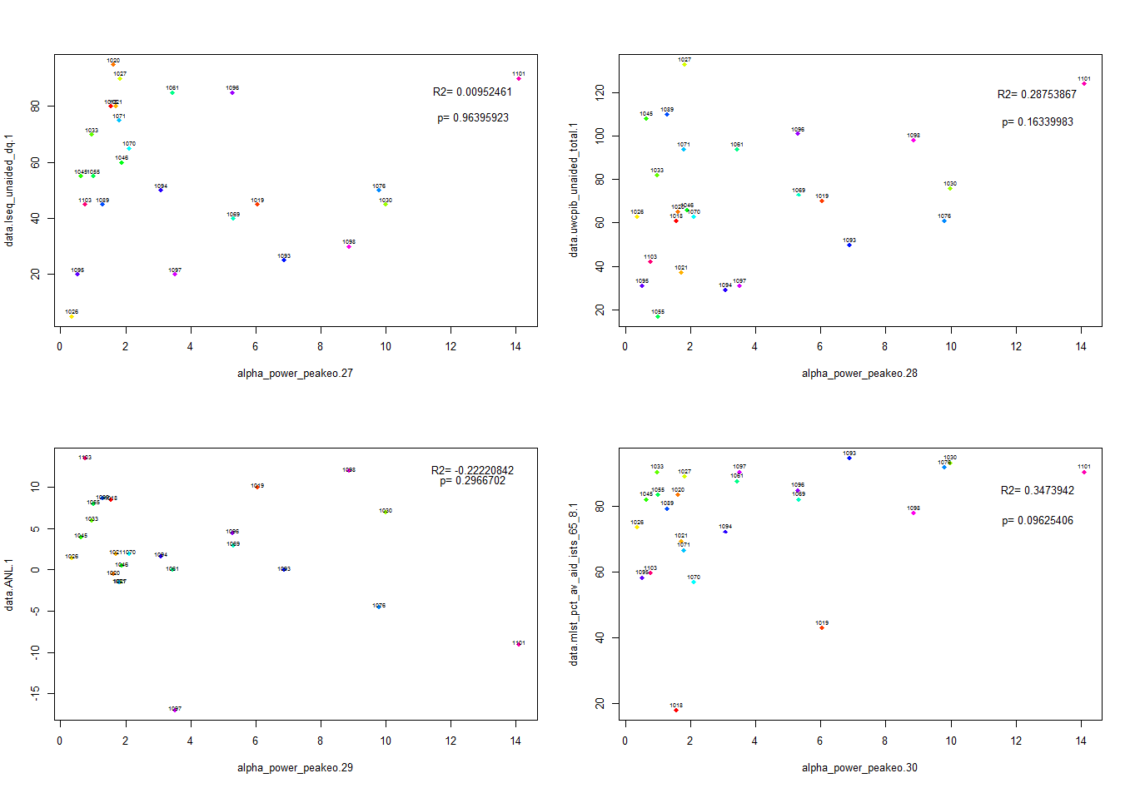
Alpha power peak (EC)-lseq unaided one-on-one
dialogue in quiet settings
Alpha power peak (EC)-ANL
Alpha power peak (EC)-MLST pct_av_aid_ists_65-8

Slide 21
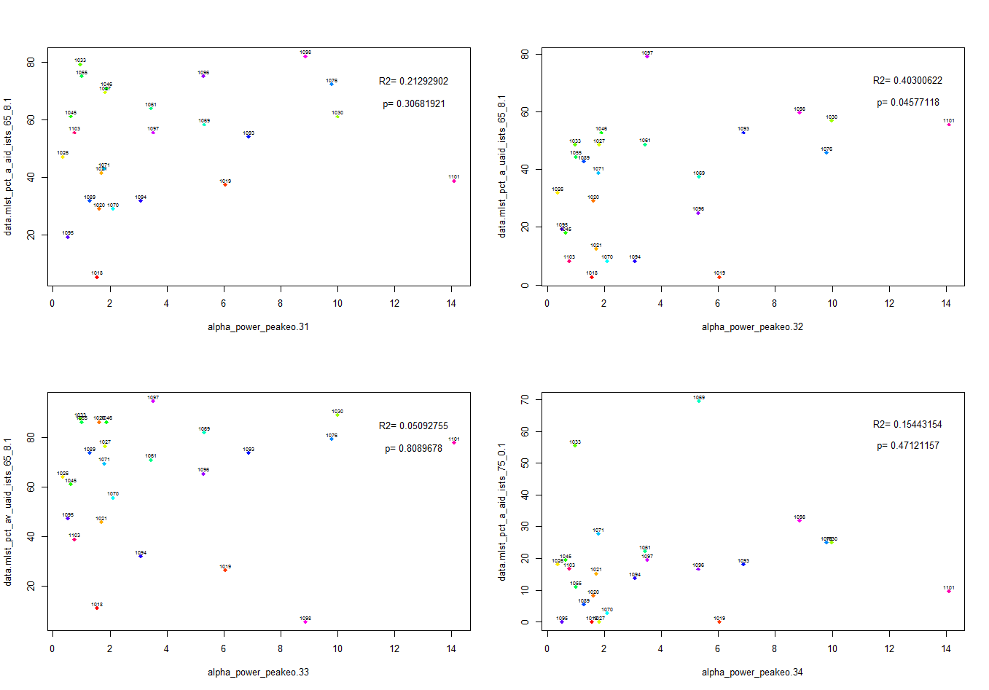
Alpha power peak (EC)-MLST pct_a_aid_ists_65-8
Alpha power peak (EC)-MLST pct a unaided ISTS 65 8
Alpha power peak (EC)-MLST pct av unaided ISTS 65 8
Alpha power peak (EC)-MLST pct a aid ISTS 75 0

Slide 22
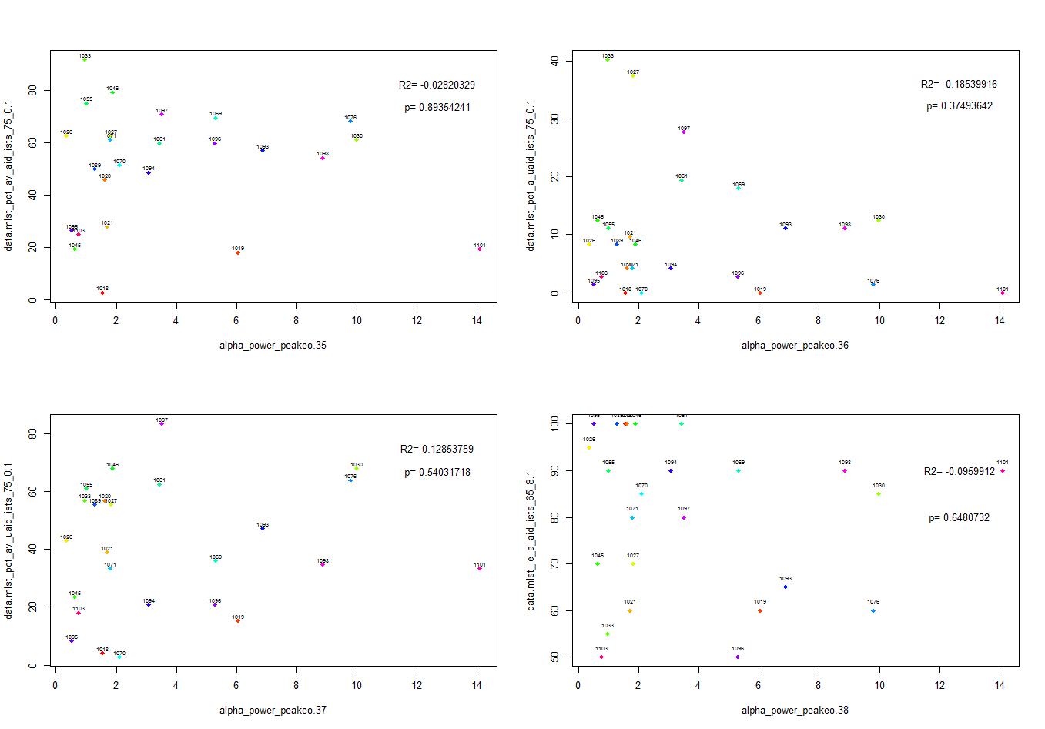
Alpha power peak (EC)-MLST pct av aid ISTS 75 0
Alpha power peak (EC)-MLST pct a unaided ISTS 75 0
Alpha power peak (EC)-MLST pct av unaided ISTS 75 0
Alpha power peak (EC)-MLST LE a aid ISTS 65 8

Slide 23
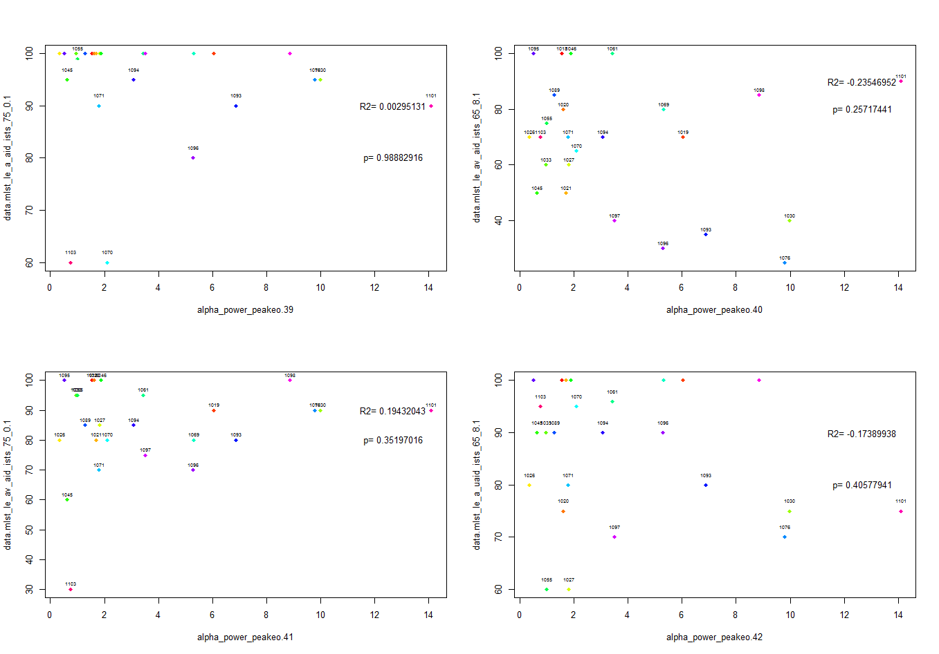
Alpha power peak (EC)-MLST Lea aid ISTS 75 0
Alpha power peak (EC)-MLST LE av aid ISTS 65 8
Alpha power peak (EC)-MLST le av aid ISTS 75 0
Alpha power peak (EC)-MLST LE a unaided ISTS 65 8

Slide 24
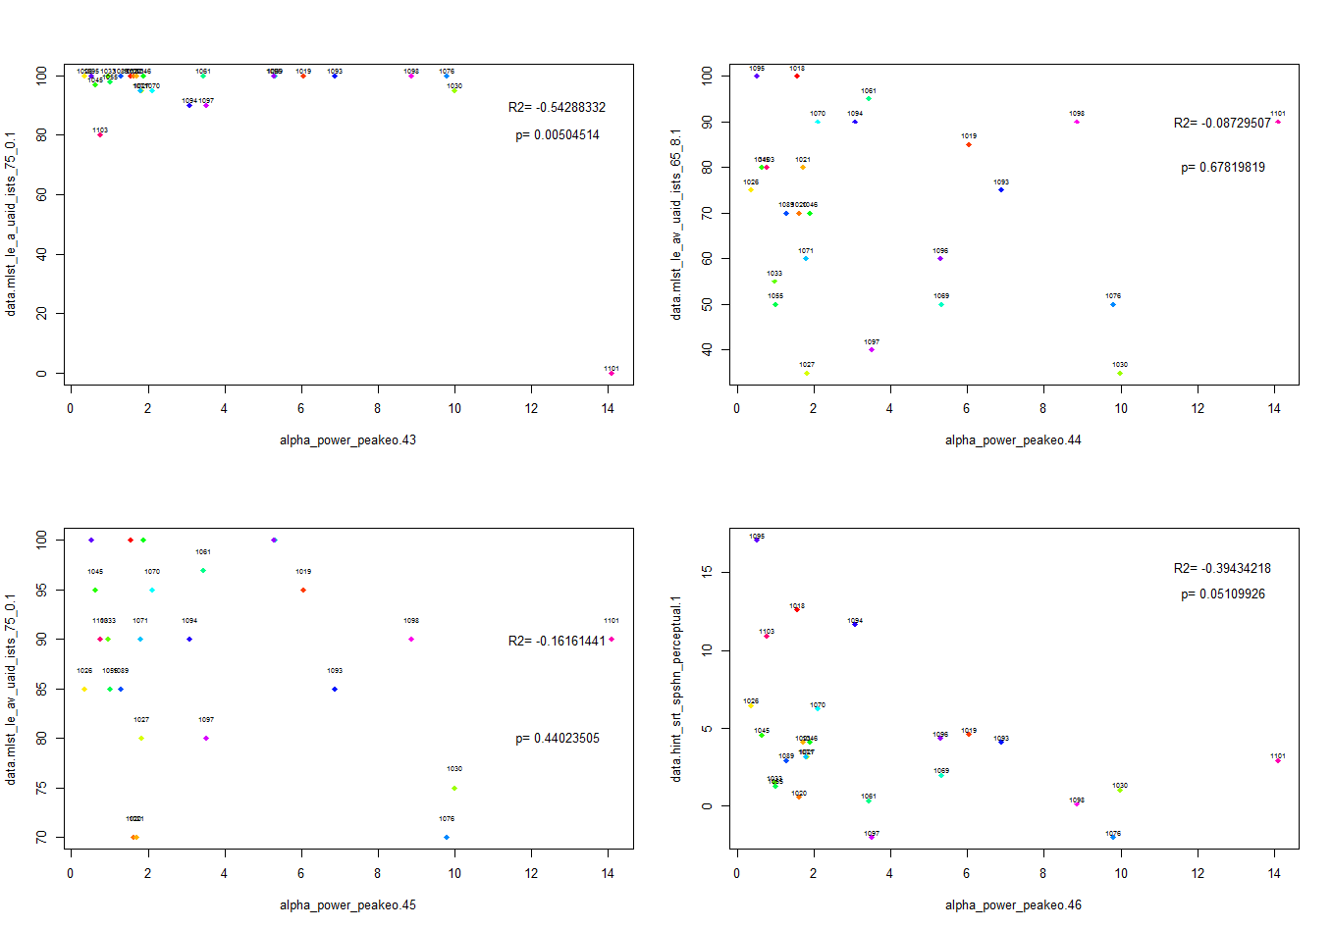
Alpha power peak (EC)-MLST LE A unaided ISTS 75 0
Alpha power peak (EC)-MLST LE av unaided ISTS 65 8
Alpha power peak (EC)-MLST LE av unaided ISTS 75 0
Alpha power peak (EC)-HINT SRT SPSHN perceptual

Slide 25
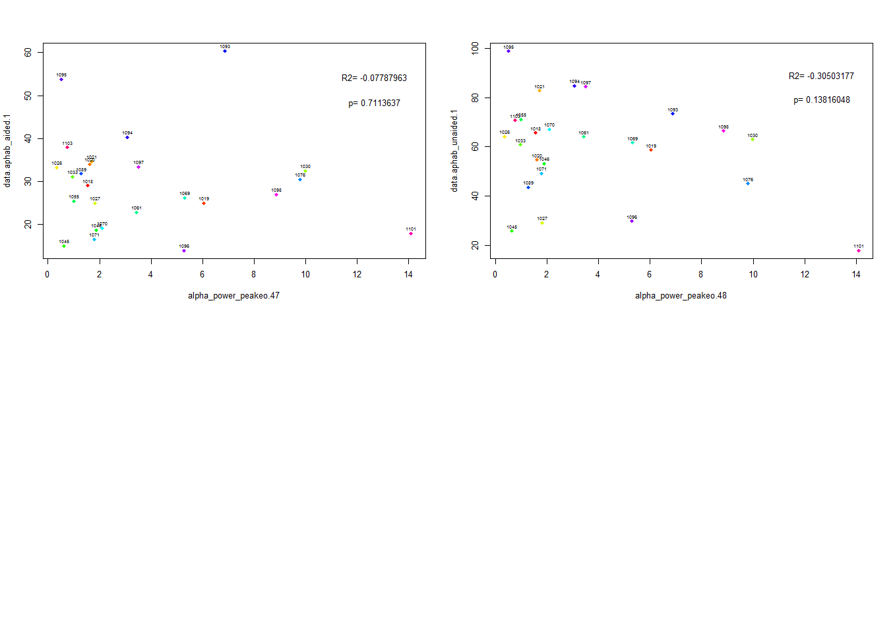
Alpha power peak (EC)-aphab aided
Alpha power peak (EC)-aphab unaided

